Slide 1



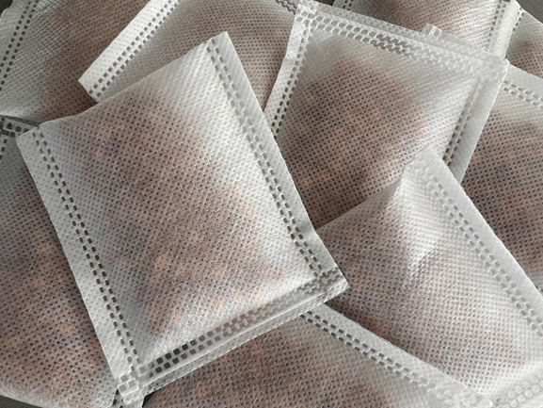
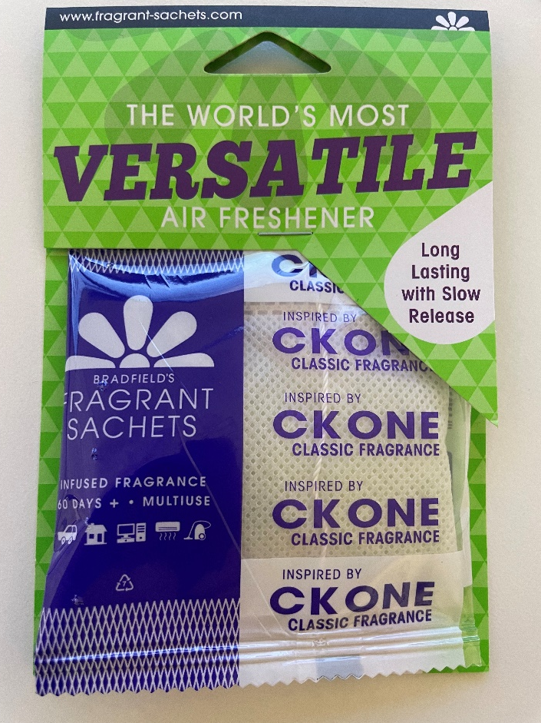

Slide 2
How did we get here?
2017 - Fundraiser needed for our Club
Rotary Fundraiser Created
Application for RI Licence turned down
Development started on plant based product
1 July 2025 – sale of property
2023 - application to Rotary Foundation Fundraising Committee
2023 - Fact-checking and creation of plant based product
2023 - RI permission obtained
2023 - Partnered with ROZops Limited Rotary Oceania

Slide 3
What is the Product?
Plant Based Air Freshener
Quality Ingredients
Slow release fragrance
Versatile – Commercial and domestic
  Car, Home, Office, Vacuum Cleaners, Heat Pumps
Developed by Bradfields
No Patent
Exclusive to Rotary

Slide 4
What is the Building Better Communities Project?
Businesses sell air fresheners to public for no profit
$8 retail price per sachet
32 sachets per month = 1 per day
Club enlists 20 businesses
Businesses identified by window sticker
Businesses prove by action
Businesses promoted by Clubs on social media
ROZops Limited promotes project on social media

Slide 5
Project Partners
KPMG
DHL
Evolution Creative
First Page
Creative IT Web Solutions
Sarah Liu

Slide 6
Project Goals
Raise Funds for Clubs
Raise Funds for Districts and the Rotary Foundation
Increase the presence and knowledge of Rotary in Communities
Create close links between Clubs and businesses in their communities
Attract new members into Rotary

Slide 7
What’s in it for a Club?
Monthly ongoing fundraiser for Clubs
Easy setup
Passive Income generator for Clubs
Engagement with your community
Vehicle for support from community
Showcase for Rotary
Increased membership for your Club
Sale Price = $8.00
Cost Price = $4.31
($8-4.31) = $3.69 * 640 = $2361.60 * 12 = $28,339.20 incl p.a.
$0.92 per sachet split between Rozops and District

Slide 8


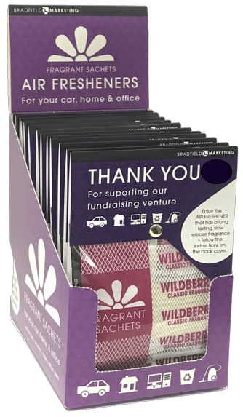


Slide 9
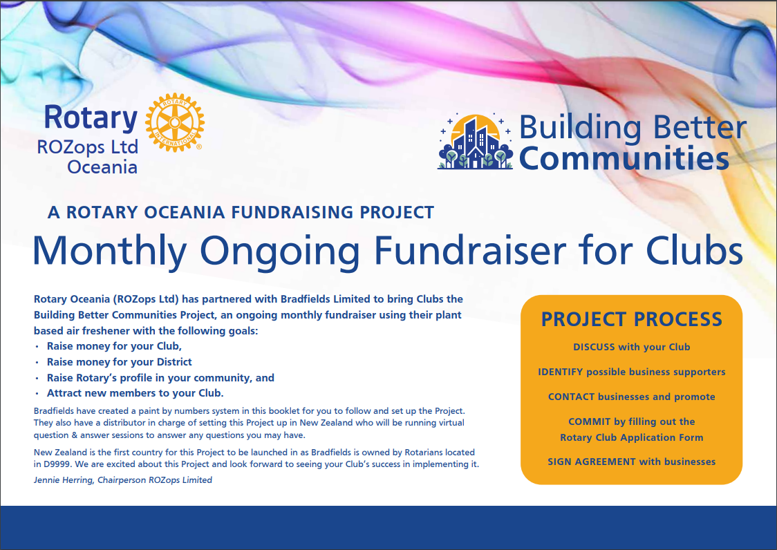
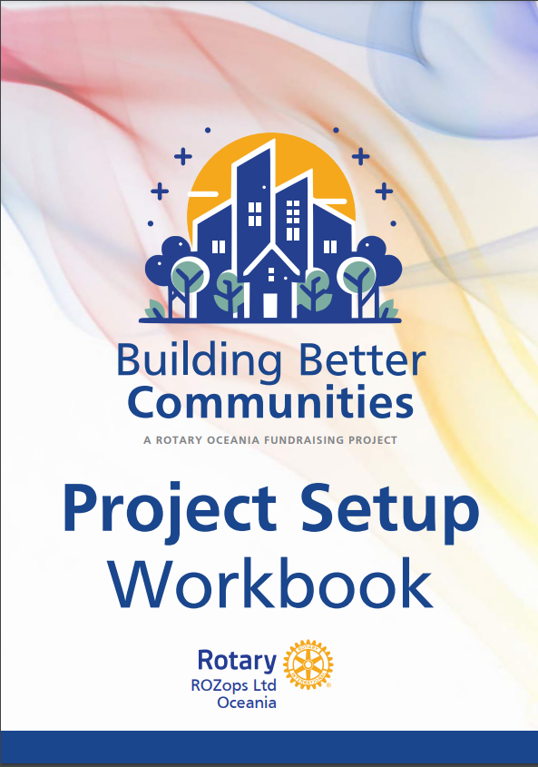
How does a Club get started?
Project information document
Project Workbook
www.bradfieldmarketing.com
National Distributor
  Gabrielle Sullivan
  gabrielle@bradfieldmarketing.com
  021 202 2067

Slide 10
Thank you
Are there any questions?

