Slide 1


Building Better Communities
Monthly Ongoing Fundraiser For Clubs
- Easy Setup
- Passive income generator for Clubs
Brought to you by ROZops Limited, Rotary Oceania

Slide 2
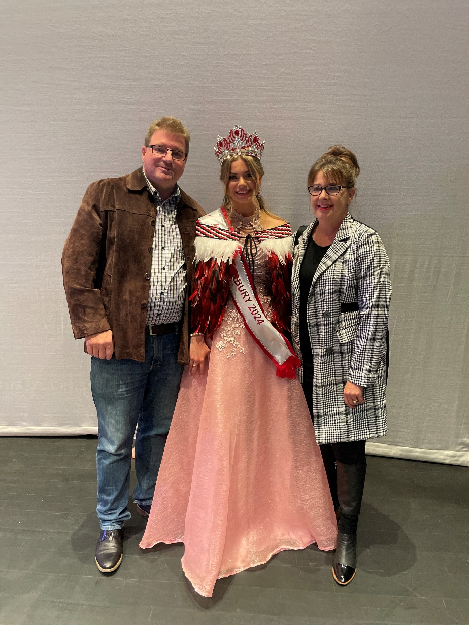
Who Are We?
Matthew Sullivan
Gabrielle Sullivan

Slide 3
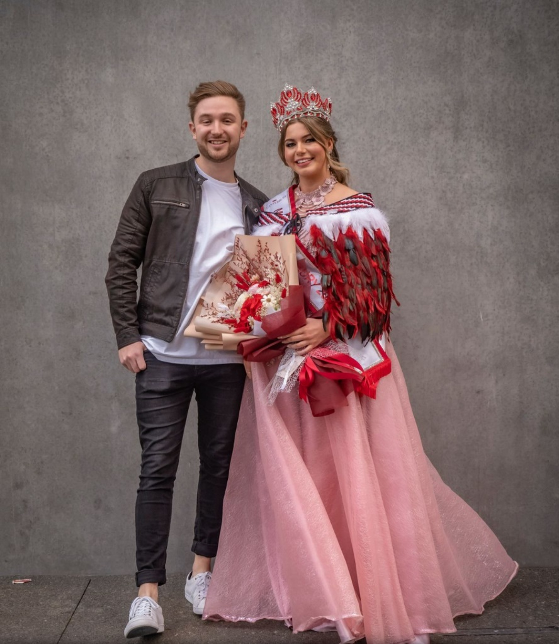
Who Are We?
Will Poultney
Paige Sullivan

Slide 4
How did we get here?
2017 development of project
2018 purchased lifestyle block with factory
2022 entered SAP agreement with a developer
2023 TRF Fundraising Committee application
2024 SAP unconditional – 81 sections
1 July 2025 settle contract and retire

Slide 5
Building Better Communities Project
Rotary Oceania (ROZops Ltd) partnered with Bradfields Limited
Product is a Sustainable Plant Based Air Freshener
Fragrance infused wooden beads
Corn Starch (PLA) sachet

Slide 6
Fragrant Sachets Promotion
A business agrees to sell 32 sachets per month with all money going to the local Rotary Club
Multiple x 20 businesses
Clubs build relationships with 20 businesses in their community
Clubs create a passive income

Slide 7
Project Goals
Raise funds for Clubs
Raise Funds for Districts
Increase the presence and knowledge of Rotary in Communities
Attract new members into Rotary

Slide 8
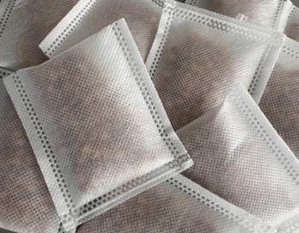
The Product
Long lasting sustainable plant based air freshener
Wooden beads, corn starch (PLA) and fragrance
Sold to businesses in 16 piece CTU
Air fresheners are packaged in Bradfields branded packaging
RI has given Bradfields permission to market their product to clubs without any reference to Rotary or the Rotary Marks on their packaging.

Slide 9
Project Partners
KPMG
DHL
Evolution Creative
First Page
Creative IT Web Solutions
Sarah Liu

Slide 10
Business Commitment
Ability to sell one sachet per day
Give all of the sale proceeds to the Rotary Club
Commitment to support the project for 1 year
Placement of the project sticker in a prominent position in business
Clubs will regularly post a list of businesses supporting the project on Social Media

Slide 11

Advertising
The project sticker identifies the business
  Being involved in the project
  Making no money from each sale
  Demonstrating that they care about their community

Slide 12


Advertising
Header Card
Full Rotary branding
Rotary message on the inside
Rotary values, etc. on the back
Changes every three months

Slide 13


Advertising
Counter Top Unit
16 sachets per unit
Rotary advertising on the sides

Slide 14



Slide 15


Advertising
Social Media Campaign
Nationwide
Monthly and on-going
Focus
      The Businesses
      Rotary
      Attracting new members
      The Product

Slide 16
Fundraising Figures - Clubs
Sale price $8.00 incl GST
Cost Price $4.31 incl GST
Each business purchases 2 x 16 piece CTU
Total sales per month = 640 sachets
Profit per month = (8.00-4.31)*640 = $2,361.60 incl GST
Profit per year = 2,361.60*12 = $28,339.20 incl GST

Slide 17
Fundraising Figures - Districts
Voluntary Royalty payment by Bradfields to Rotary
$0.92 incl GST per sold sachet paid to Rotary
50% paid to Districts if 95% of Clubs involved in project
25% paid to Districts if less than 95% of Clubs involved
Balance is paid to ROZops

Slide 18
Fundraising Figures – Districts excl GST
272 Clubs @ 640 sachets @ $0.92 * 12 = $1,921,843 each year
District | # of Clubs | $ @ 50% ($0.46) | < 95% of Clubs | $ @ 25% ($0.23) | $ Difference
9910 | 52 | $183,705 | 48 | $84,787 | $98,918
9920 | 61 | $215,500 | 57 | $100,684 | $114,816
9930 | 56 | $197,836 | 52 | $91,852 | $105,984
9940 | 40 | $141,312 | 37 | $65,356 | $75,956
9999 | 63 | $222,566 | 59 | $104,217 | $118,349
ROZops | 272 | $960,921 | 253 | $1,474,944 | $514,023

Slide 19
Product Ordering
One order and one delivery per month
Monthly standing order
Each shipper contains 20 CTU’s
Minimum order = 1 x shipper

Slide 20
How to Order
Bradfields website – Product advertisement
Access to ordering portal
2 users per Club – President and Treasurer
Ability to have standing order and one off orders
Notification given before the order cut-off

Slide 21
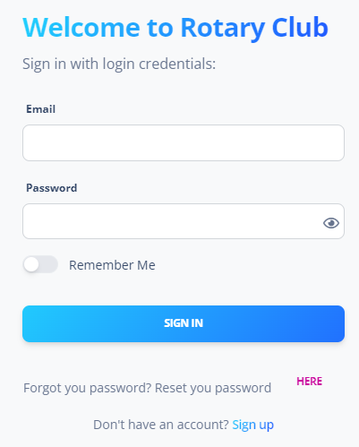
Signing In

Slide 22
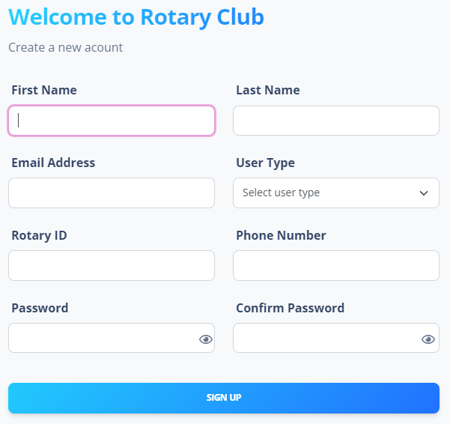
Signing up

Slide 23
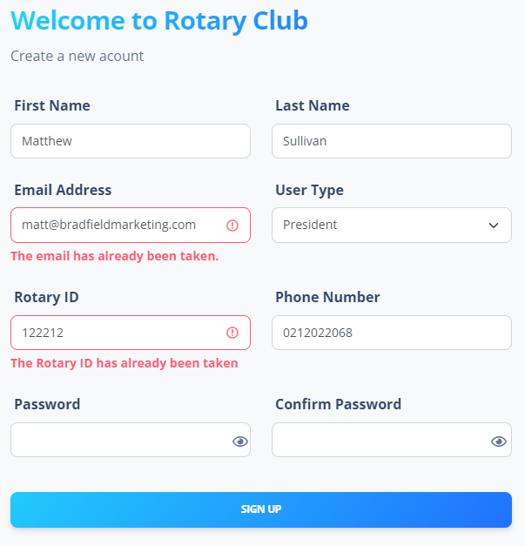
Signing up

Slide 24
Signing Up – Club Details
  Club Name
  RI Club ID:
  Club Type
  Club Tax Number
  Mailing Address
  Rotary District
  Rotary Zone
  Club Email Address

Slide 25
Signing Up – Club Officer Details
  First Name
  Surname
  Rotary ID
  Email Address
  Phone Number
  Signature
  Treasurer/President Email Address

Slide 26
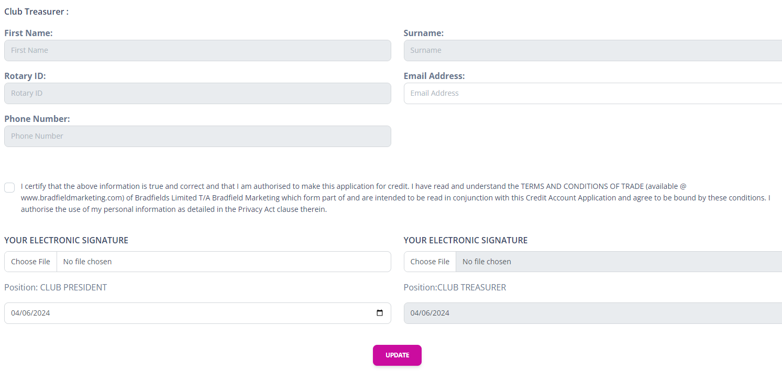

Slide 27
Terms & Conditions

Slide 28
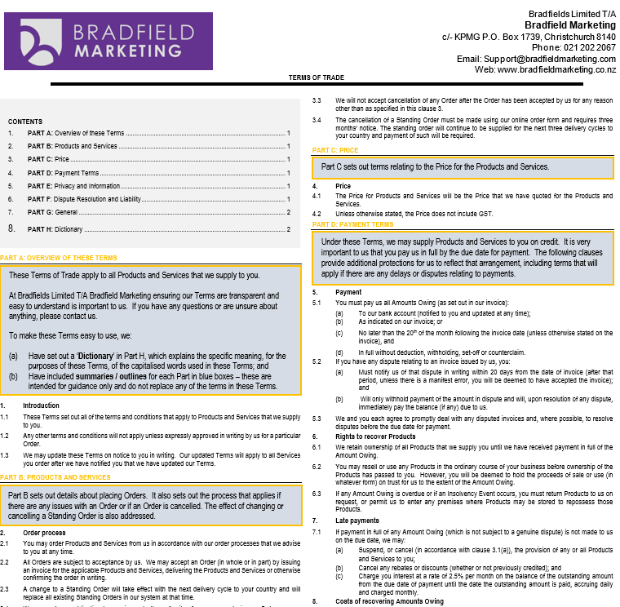

Slide 29
Signing Up
Emails Sent
  Treasurer
  Club
  President
Treasurer signs in
  Completes application
  Name, Rotary ID, Phone Number
  Signature
  Terms

Slide 30
Signing Up
Emails sent
Bradfields approve account
  Rotary Club ID
  President Rotary ID
  Treasurer Rotary ID
Emails sent

Slide 31
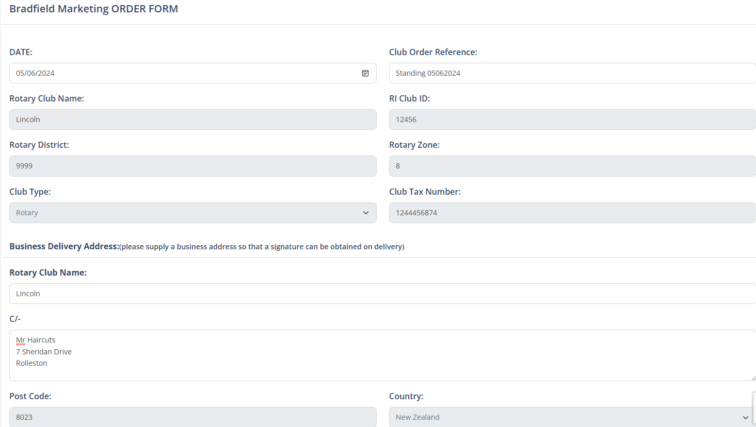
Creating Order

Slide 32
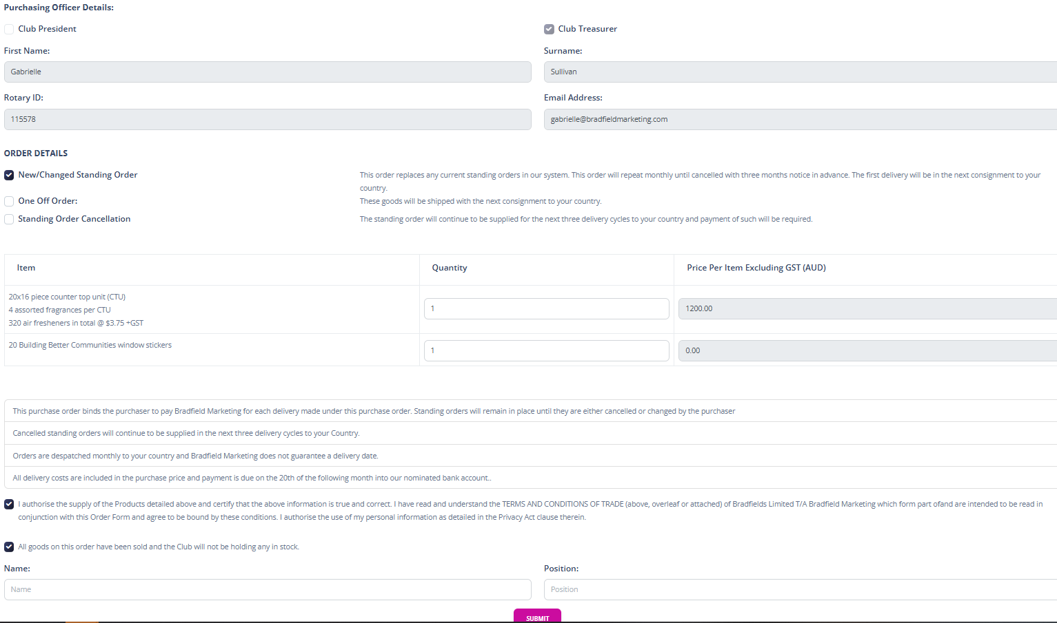
Creating Order

Slide 33
Product Ordering
One order and one delivery per month
Monthly standing order
Each shipper contains 20 CTU’s
Minimum order = 1 x shipper

Slide 34
Order Placement and Delivery
KPMG receive the monthly order info
KPMG place the order with the factory
KPMG produce the Club invoices and delivery dockets
KPMG pay the invoices and calculate the monthly Royalties
Club produces invoices for each business
Rotarian delivers the monthly order and invoice to each business

Slide 35
Unsold Air Fresheners
Rotary Club
Businesses each commit to being involved for 1 year
Club confirms before placing an order that all sachets are sold
Social media advertising will attract businesses wanting to be involved
Collaboration within the District Community Groups

Slide 36
Unsold Air Fresheners
Participating Business
Goal is to sell one sachet per day = 32 per month
Product placement
Education of staff
Sticker on business
Social media advertising – Club and Rotary Oceania

Slide 37
Club Requirements
Preparation of monthly invoice for each business
Delivery of product monthly to each business
Build a relationship with each business
Welcome the businesses into the club
Hold meetings to celebrate the businesses

Slide 38
District Requirements
Opportunity to create passive incomes for both Clubs and Districts
Encourage the Clubs to get involved
Tell the Clubs what the District Royalty will be used for
We may need assistance in verifying Clubs,Presidents and Treasurers

Slide 39
Additional Resources
National Distributor
  Gabrielle Sullivan
There to assist Clubs in getting setup
Zoom Q and A sessions

Slide 40
Additional Resources
Project Information Booklet
Project Setup Booklet
Safety Data Sheets
Presentation Pack
Available to anyone off Bradfields website
Full transparency between Rotary and Communities

Slide 41


Slide 42
Additional Resources
Club Setup and Business Identification Worksheet
Paint by numbers system
Mental attitude
Community and business identification
Pre-approach questions to ask before adding to the list
List of businesses to approach worksheet

Slide 43
Additional Resources
Club Setup and Business Identification Worksheet
How to approach a business
Appointment script
The appointment
Presentation items

Slide 44
Additional Resources
Club Setup and Business Identification Worksheet
How to approach a business
Appointment script
The appointment and the follow-up
Presentation items

Slide 45
Additional Resources
Presentation Items
Cover Sheet
Letter
Project overview
Club Credit Application Form
Order Form

Slide 46
Additional Resources
The follow-up procedure
Project Checklist

Slide 47
What’s Next
Website
  Testing is nearly completed on the Club Ordering System
  Building the front end is underway
  Workbook is being formatted
  ROZops will be notified

Slide 48
What’s Next - Clubs
  Specialists
  Business Identification
  Phone Calls
    Making appointments
  Presentation pack preparation
  Attending appointments
  Following up
  Start building your teams
    Project Leader
    Specialists
    Business Liaison Members

Slide 49
What’s Next - Bradfields
Get system tested
Website front end
Workbook completed
Advertising planned
Visit China
  Meet with Sarah
  Help with setup
  Establish quality

Slide 50
What’s Next – New Zealand Rotary
First Order Placement
  New Zealand is the first country
    Minimum order 45,000 sachets = 71 clubs @ 640
  After first order arrives it will be a monthly cycle
  Advertising starts when the first order arrives
    45,000 * $0.25 = $11,250 placement cost.

Slide 51
What’s Next – 1 July 2025
Matthew and Gabrielle
  Travel and introduce project to new countries
  62,000 Clubs
Paige and Will
  Take over the day to day running

Slide 52
Project Goals
Passive income for Rotary Clubs and Districts
  Just like Lions
Increased Rotary exposure with in the Districts and communities
New Rotary members
Building Better Communities with Rotary at the centre

Slide 53
Thank you

