Slide 1

DIO Presentation for Zone 8 GETS 3pm Sunday 10 Sep 2023
This presentation:
  Updates on the insurance programmes and is consistent in format since 2020
  Provides the information for:
      the ROZops Board for its Board meetings
      the Oceania DG train both at GETS and on request
      Is presented to DIO’s at Oceania DIO meetings (which have a standard agenda)
      Is used District DIO for District LETS presentations

Slide 2
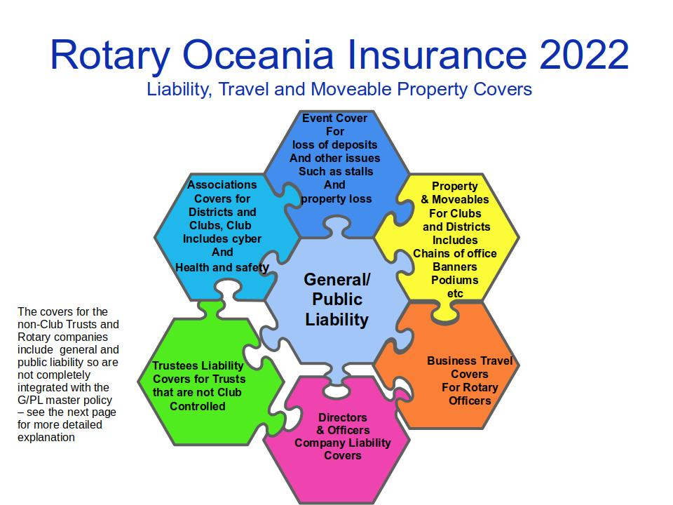
Presentation to Oceania Governor’s Elect at GETS 2022

Slide 3
2023 Programme - Overview
Policy | Insureds | Insurer | Broker | Next Renews/Issues | Unit
Forefront Associations All lines excl PL | Incorporated Clubs, Districts under Master Policy and the Clubs own Club Trust * a Club Trust is a trust governed by the Club’s executive | Chubb | AON | (a) Renews 1 January 2024 (b) new requirements for cyber, revenue, additional entities including trading trusts and special purpose companies (c) AON advice on limits and excesses (d) self-service of CoCs with named parties | 1. Per capita levy paid by District 2. optional extensions for extra insureds as named controlled parties – trading trusts and SPCs (special purpose companies) 3. Admin fee per Club 4. CoC with named parties

Slide 4
2023 Programme - Overview
Policy | Insureds | Insurer | Broker | Next Renews/Issues | Unit
Chubb Multi-national Public Liability Only | Incorporated Clubs, Districts under Master Policy | Chubb | AON | 1 January 2024 | Per capita levy
Forefront for Independent Trusts * for trading trusts or trusts that are not a Club Trust | This is a master policy for those non-Club trusts that opt-in for Trustees Cover. Note: Club Trusts are covered under the Associations policy. | Chubb | AON | 1 January 2024 | Per Trust based on proposal

Slide 5
2023 Programme - Overview
Policy | Insureds | Insurer | Broker | Next Renews | Unit
Forefront for Rotary Companies | This is a master policy for those companies that opt-in for Cover * Youth programmes are not permitted unless specifically covered but are covered by the Chubb Mutlinational Gneral/Public liability policy and if accommodation is required by adding and Event policy cover. | Chubb | AON | 1 January 2024 | Per company based on a proposal
Moveables | Incorporated Clubs, Districts under Master Policy * being re-marketed by AON NZ on a $250k limit with $1k excess Cancelled due to lack of take up | Vero | AON |  | Per District and Club with declared assets required if any single asset is valued at more than $5000
Events Cover | Incorporated Clubs, Districts and companies under Master Policy * Underwriting submission completed. Schedule of known events and awaiting terms to AON NZ | Event Cover | AON | 31 December 2023 | Per event based on event proposal

Slide 6
2022 Programme - Overview
Policy | Insureds | Insurer | Broker | Next Renews | Unit
Corporate Rotary Travel Cover | Incorporated Clubs, Districts and companies under Master Policy * Underwriting submission completed. Business policy in place. | tai/Canopius | AON | 1 January 2024 | Travel days based on travel advice
Personal Lines Travel | Travellers that are or are associated with any Club Programme * Underwriting submission completed. Terms are being sought with AON | No carrier at this point | AON |  | Travel days based on travel advice
Personal Lines – Householders and MV | Member of any Club Programme * Underwriting submission being worked on – carrier dependant Terms are being sought with AON with Vero | TBA | AON |  | Per proposal

Slide 7
The peril of double insurance
Different types of organisations, incorporated societies, trusts and companies are part of how we are organised and work. As the risks are different for the different entities, we have to work with our brokers and insurers to make sure the insurance is the right policy for each type of entity. This is the same with assets. Insuring a house is different from insuring a car!
Your insurance team that works on insurance issues needs experience or to have members that are willing to learn about the different types of cover.
A specific issue that your team has dealt with is when policies overlap leading to duplicated cover.
This issue is most often encountered in health insurance and, in particular, by travellers who may have un-intentionally taken up duplicated covers by buying travel insurance and having ‘free’ cover via a credit card program. This can lead to having to make claims under both policies and the danger that each policy requires the claim to be processed first by the other insurer – the double insurance peril.
Your team has had to deal with this issue to ensure each of the policies fit together or stand alone.
This is why the graphic on the previous page shows the Trust and Company policies as not being interlocked in the jigsaw with the General/Public Liability. Each of those policies for non-Club trusts and Rotary companies have their own General and Public liability sections so the insurance cover for General/Public liability for those entities is they are running an event is not the $10million cover that is in the Chubb Multi-national General/Public liability policy.
Finally, if an event has risks relating to activities such as sport based events, community fairs, trade exhibitors, garden or house tours, attendee accommodation, live music and, generally where tickets may be sold to the public the event organiser needs to consider whether the General/Public Liability cover needs to be extended by EVENT INSURANCE. That cover is available and organised under a national policy with Sage, a Lloyds of London insurer through its local arm, Event Cover. There is a specific agreement in the 2 policies to cover double insurance. This required both insurers to agree. The event cover has been obtained at a favourable rate per event and if that cover is needed the peril of double insurance is avoided.
Here is the detail relating to the clauses in each policy:
The Event Cover policy at Clause 14. states:
Other Insurance If the INSURED is entitled to indemnity under any other insurance, this POLICY shall operate in excess of such other insurance, even if the other insurance policy has another insurance condition to similar effect.
The Chubb Multinational General/Public Liability Policy states under General Condition 5.11
Other Insurance If other valid insurance with any other Insurer is available to the Insured covering a loss also covered by this Policy, then Chubb shall only be liable for the amount payable in excess over and above such other insurance.
This conflict of terms has been resolved by
Event Cover agreeing that its policy will receive the claim
and Chubb will only be involved if the claim goes over the Event Cover limit of $2m.

Slide 8
Summary
Liability covers are in place
We are now preparing for renewal
Process starts with AON advice to Oceania team – due 13 September
Oceania team will then consider and meet with AON
Data collection per Club is expected to start mid_October to complete by mid November
AON to complete term sheet negotiations by early December
Policy docs to issue automatically to all Districts Club and Trusts to include Certificate, Schedule and Wordings

