Slide 1

Project One/Flectra

Slide 2
REMINDER Why ROZOPS ? – Specific Drivers
Clubrunner - cost, lack of Zone functionality, Events, Club membership, integrations
Alumni and transfer between programmes
RI Youth Activity Wellbeing policy(YAWP) especially RYE and Police Vetting
The 2020 Privacy Act
Public Image
Rising volunteer effort
Rotary at the Corporate level – support and development
Resources for Rotaract
National Communication
Central management of other web services through single sign-on
Managing permissions and access logging to sensitive data - children

Slide 3
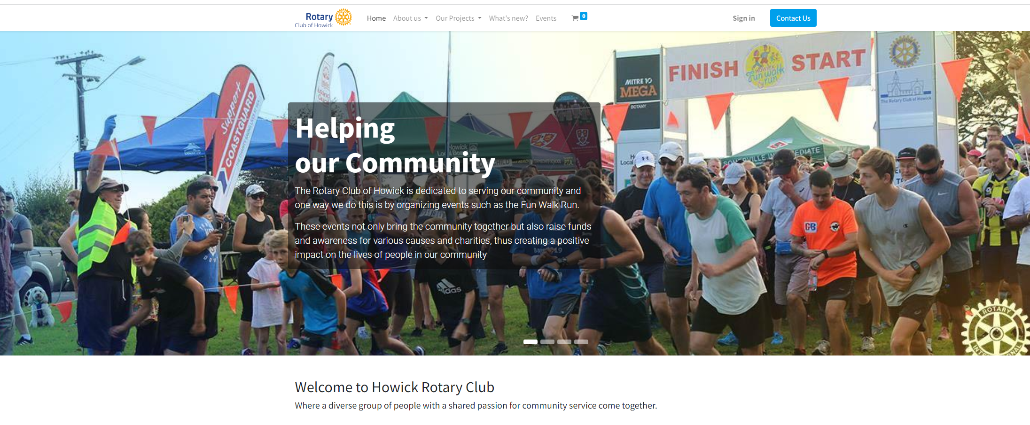
Modern looking websites that are easy to edit and have full ecommerce capability

Slide 4
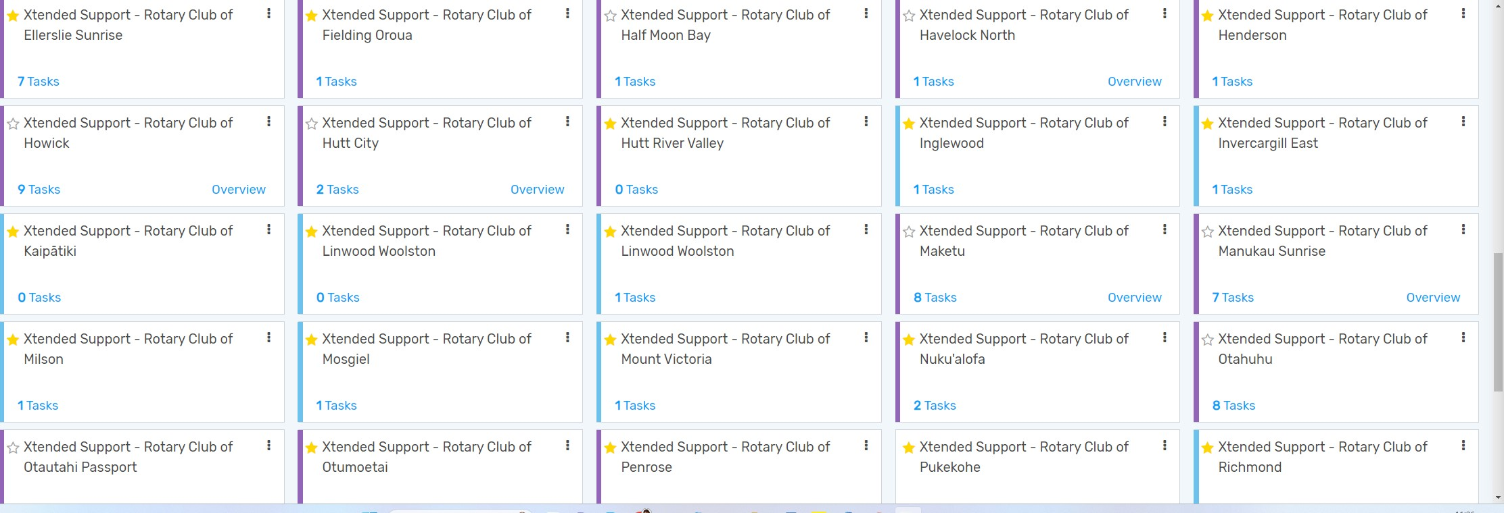
PROJECTS
Clubs are already using the system – Onboarding or through the helpdesk for assistance eg for Insurance. This is the Projects Module with Followers for each task

Slide 5
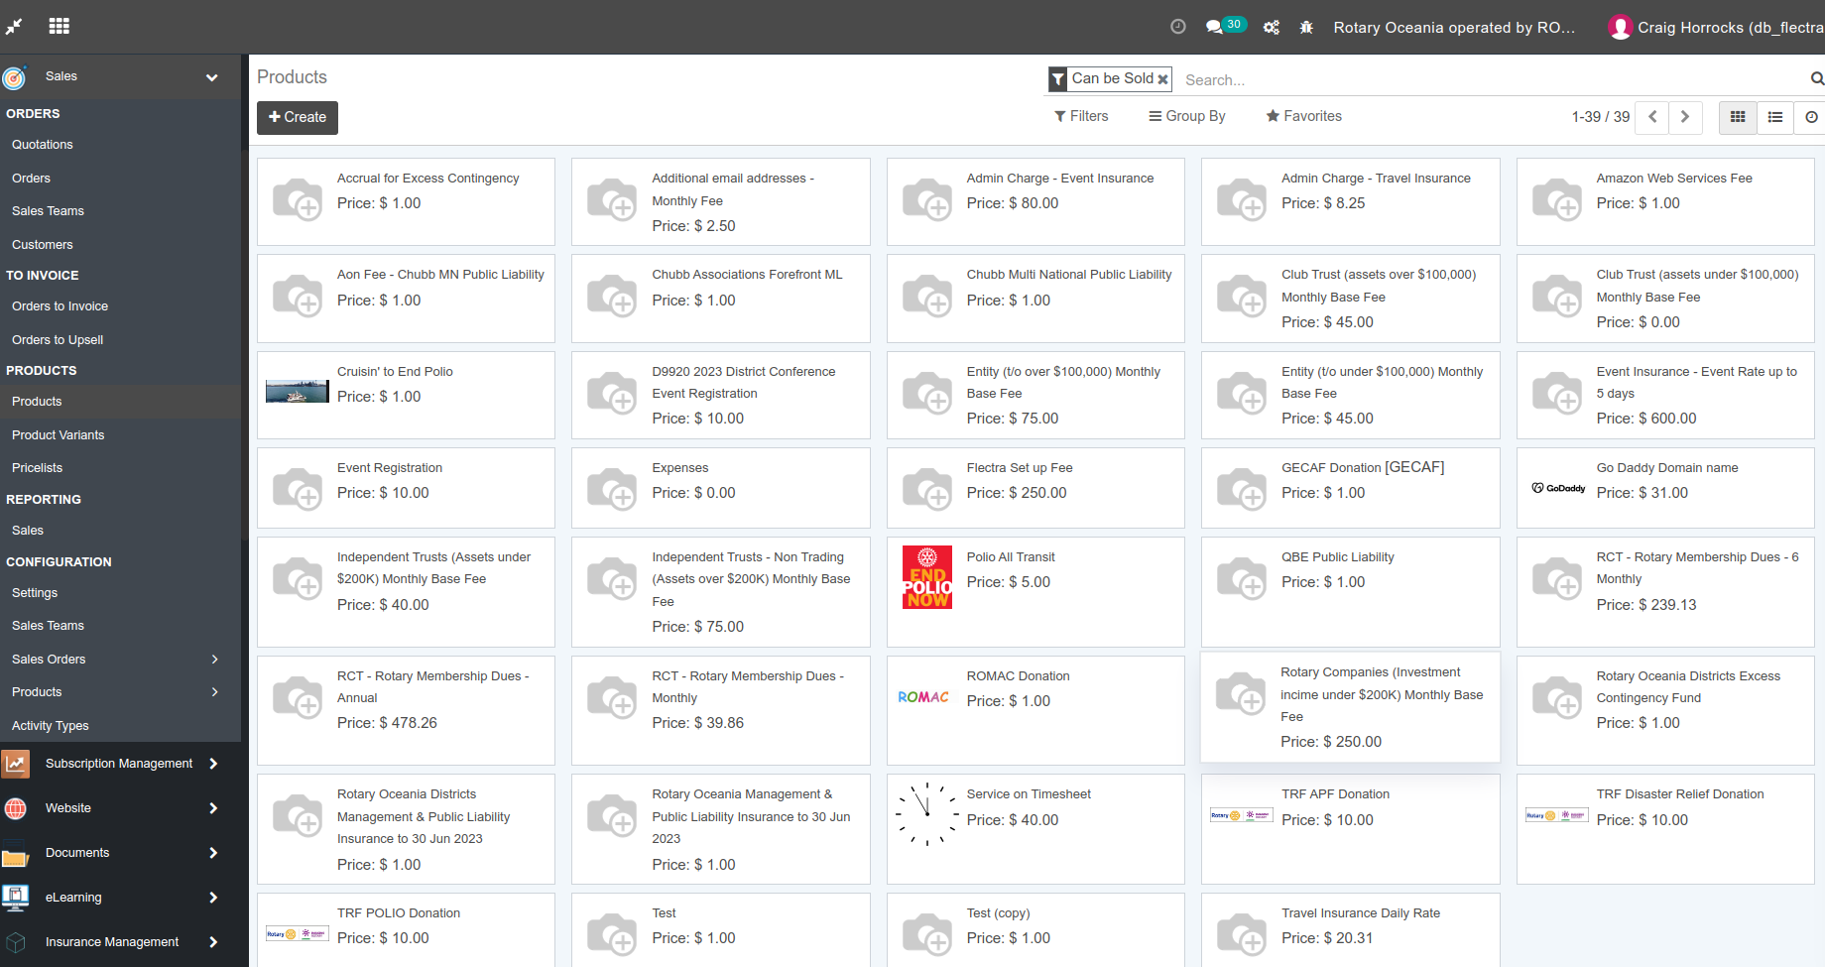
PRODUCTS
Products can be added and sales done through Windcave – event tickets, products and donations

Slide 6
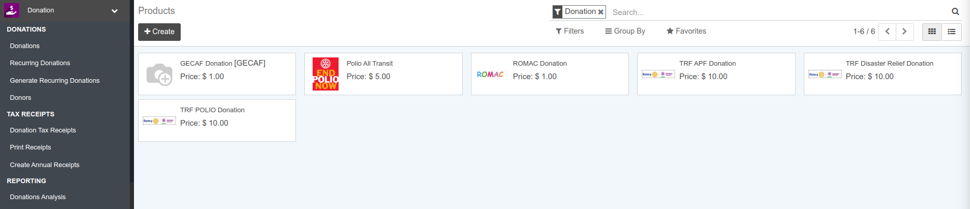
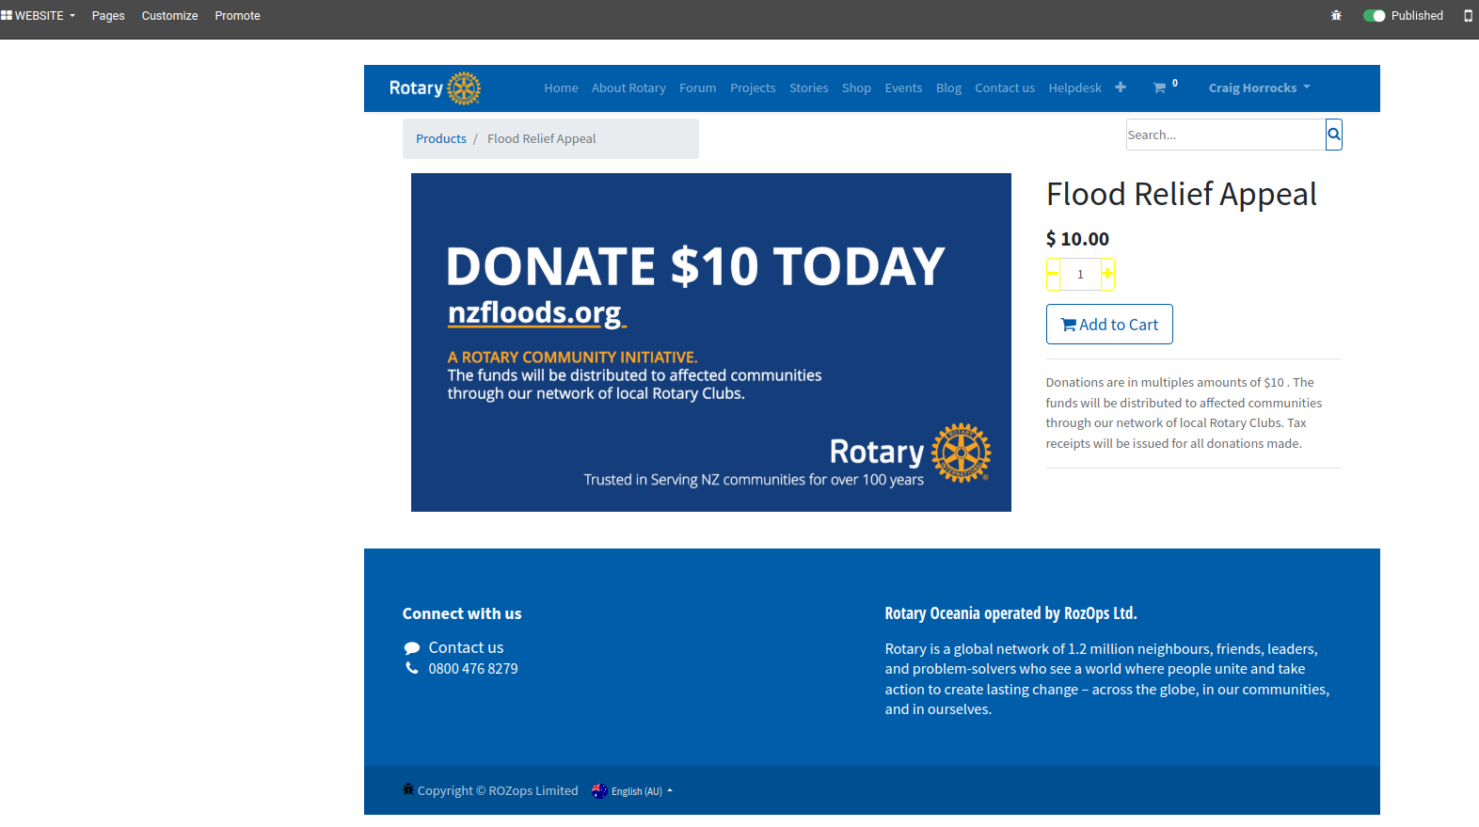
DONATIONS
The Donations sub-system
Is also being established and used with the nzfloods appeal being a demonstration of the new capabilities

Slide 7
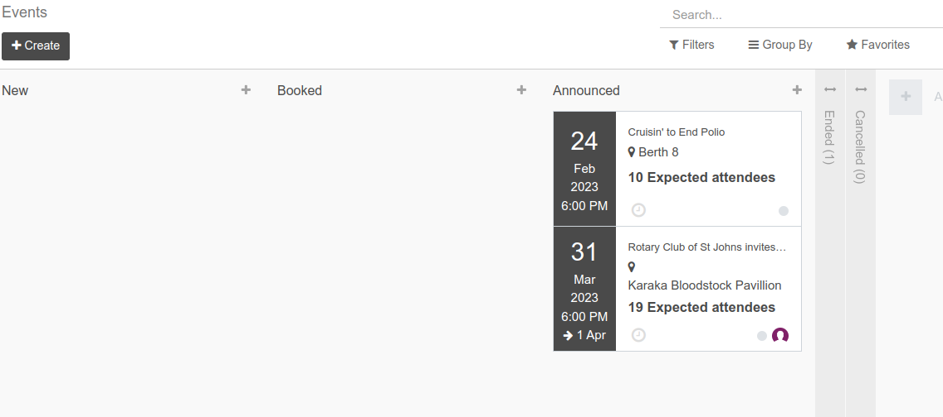
TICKETS/EVENTS
The inbuilt event management is being used to set up
and market events be it club meetings and events or district events

Slide 8
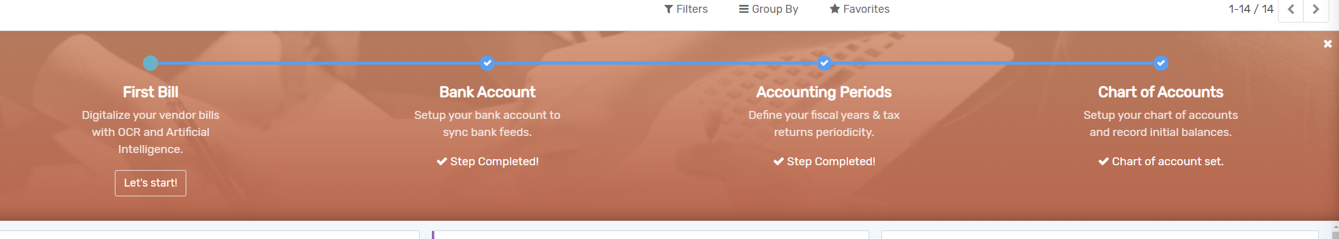
ACCOUNTING
Full in built accounting system
Accounting is part of the Flectra system (and included in the subscription) Its is especially useful for clubs who cant afford Xero. It is an option for clubs to use and is not mandatory.

Slide 9
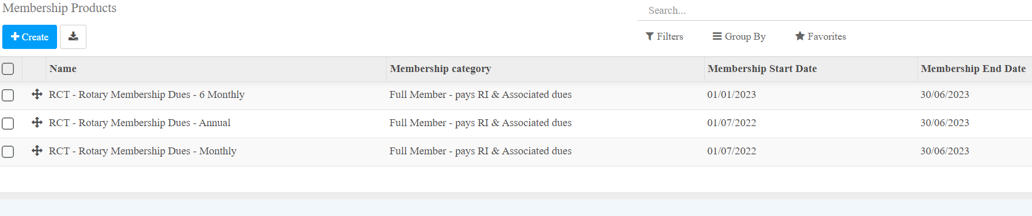
MEMBERSHIP BILLING
Easy membership billing
With automatic billing on your terms
Keep track of members skills, contact details, positions and roles. Easily search for contacts.

Slide 10
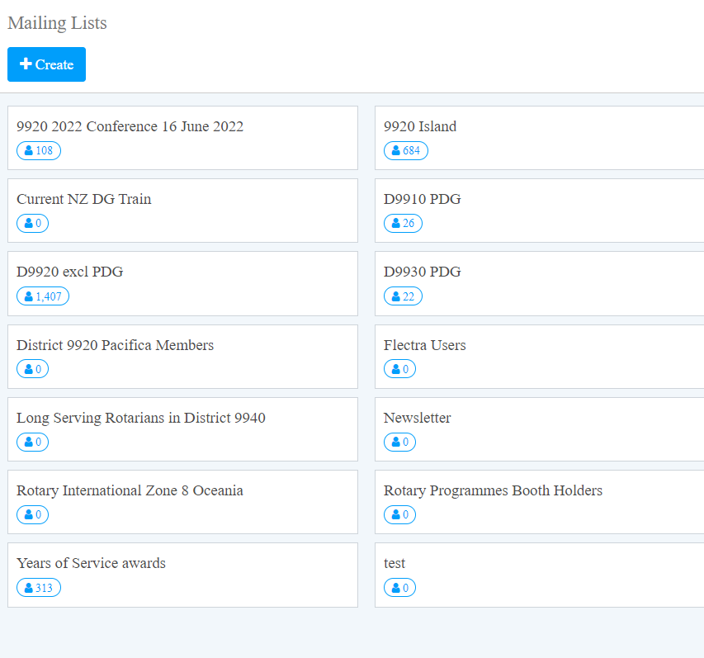
COMMUNICATION
Mailing lists for easy marketing.
SMS (text messaging) coming with the Dashboard Project

Slide 11
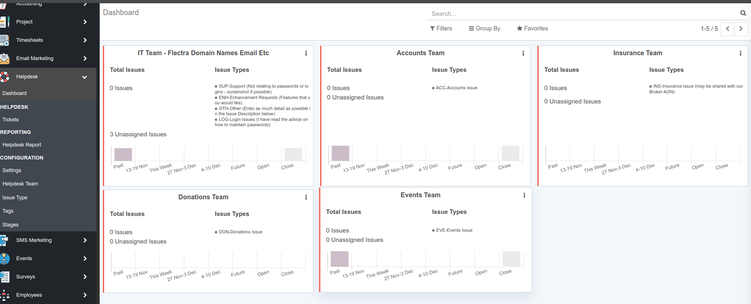
HELPDESK
The inbuilt Helpdesk functions is being used to address specific requests

Slide 12
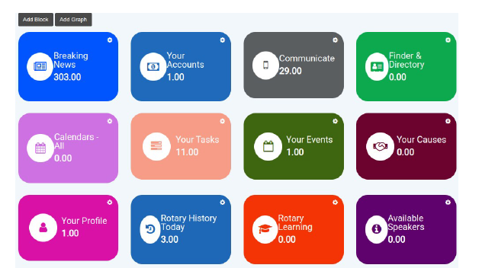
DASHBOARD
Dashboard Project – awaiting funding
Will provide a simple day-to-day member experience allowing members to communicate about meetings and projects, sort out catering and speakers, check Rotary calendars, update contact details and view communications (just to name a few) all from one easy to use screen.

Slide 13
Where to from here?
To start your clubs onboarding or if you have any further questions then file a helpdesk ticket at rotaryoceania.zone/helpdesk-form
To donate to the Future of Rotary through the Dashboard Project click here
If you would like to volunteer to join our implementation and ongoing support team please email
Operations-manager@rotaryoceania.com
If you are a web designer or have an accounting background and wish to be available to assist clubs where required for a small remuneration please email
Operations-manager@rotaryoceania.com

